Slide 1
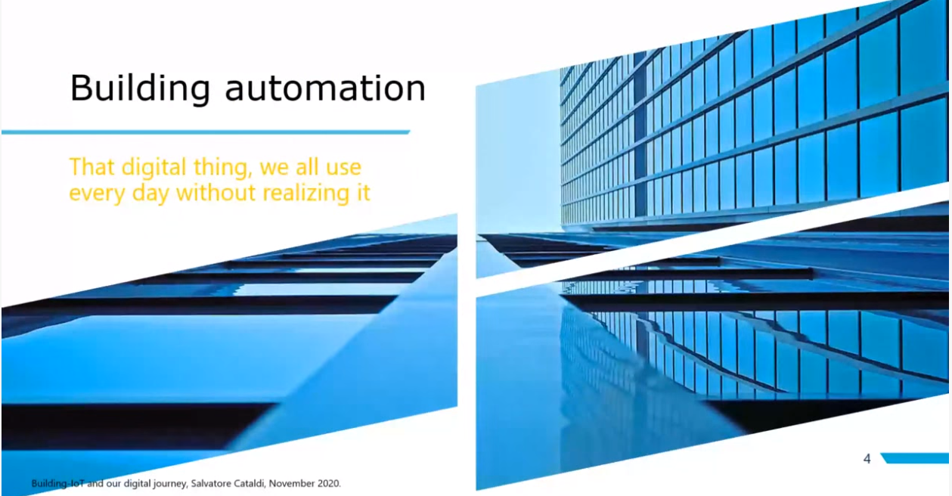
Building Automation
That digital thing that we use everyday without even realizing it
Building automation is the automatic centralized control of a building's HVAC (heating, ventilation and air conditioning), electrical, lighting, shading, Access Control, Security Systems, and other interrelated systems through a Building Management System (BMS) or Building Automation System (BAS).
https://en.wikipedia.org/wiki/Building_automation#:~:text=Building%20automation%20is%20the%20automatic,Building%20Automation%20System%20(BAS).

Slide 2
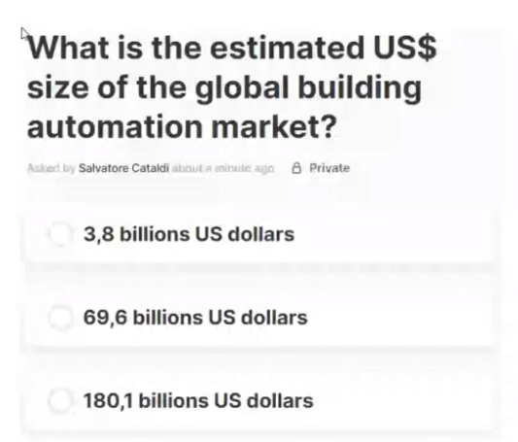
The estimated us $ size of the global building automation market
69.6 billion US dollars

Slide 3
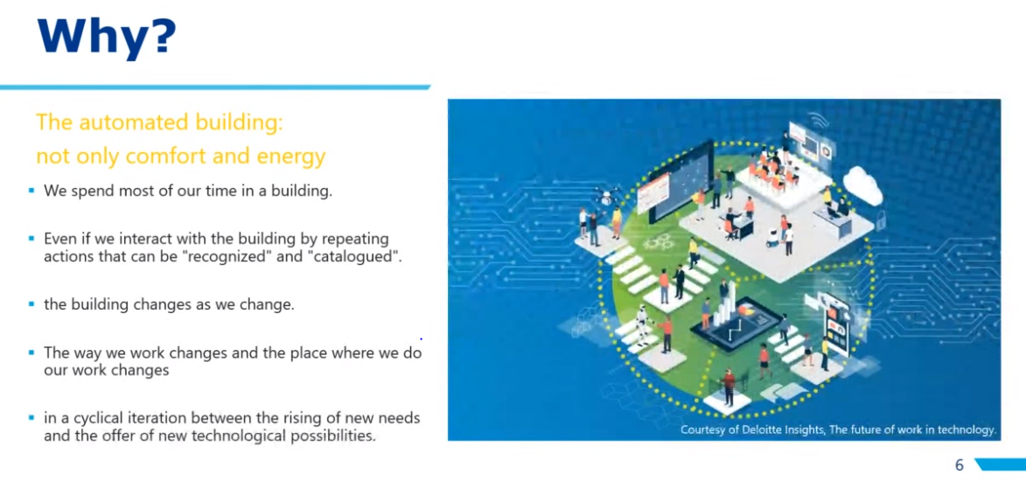
Why do we need to do building automation
We spend most of our times in a building
Even if we interact with the building by repeating actions that can be “recognized” and “catalogued”
The building changes as we change
The way we work changes and the place where we do our work changes
In a cycling iteration between the rising of new needs and the offer of new technological possibilities
The above are all the reasons as to why we felt the need for building automation.

Slide 4
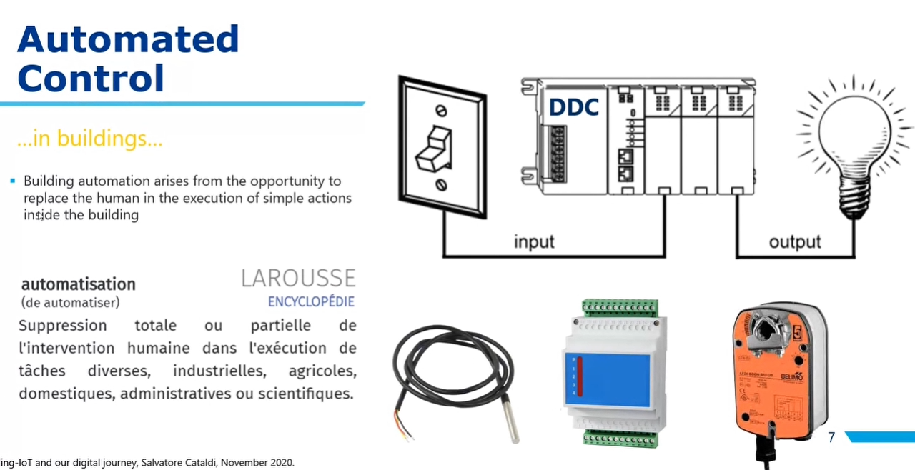
Automated control in building
Building automation arises from the opportunity to replace the human in the execution of simple actions inside the building.
Left is a temperature sensor. A temperature sensor is an electronic device that measures the temperature of its environment and converts the input data into electronic data to record, monitor, or signal temperature changes.
Microprocessor Controller: Microprocessor consists of only a Central Processing Unit, whereas Micro Controller contains a CPU, Memory, I/O all integrated into one chip. Microprocessor is used in Personal Computers whereas Micro Controller is used in an embedded system.
Actuator: An actuator is a component of a machine that is responsible for moving and controlling a mechanism or system, for example by opening a valve. In simple terms, it is a "mover". An actuator requires a control signal and a source of energy.

Slide 5
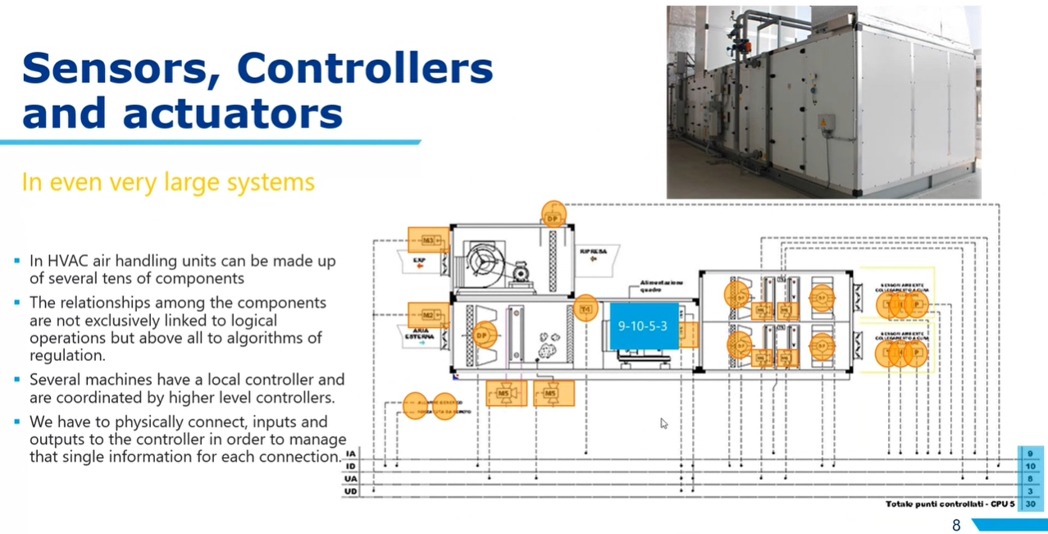
Sensors, controllers and actuators
In HVAC air handling units can be made up of several tens of components. Heating, ventilation, and air conditioning(HVAC) is the technology of indoor and vehicular environmental comfort. Its goal is to provide thermal comfort and acceptable indoor air quality.
The relationships among the components are not exclusively linked to logical operations but above all to algorithms of regulations
Several machines have a local controller and are coordinated by higher level controllers
We have to physically connect, inputs and outputs to the controller in order to manage that single information for each connection.

Slide 6
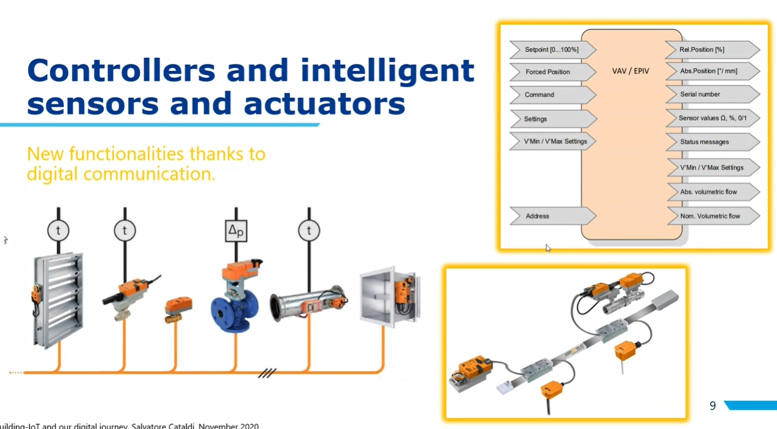
Controllers and intelligent sensors and actuators
- A bus is a subsystem that is used to connect computer components and transfer data between them. ... A bus may be parallel or serial. Parallel buses transmit data across multiple wires. Serial buses transmit data in bit-serial format.

Slide 7
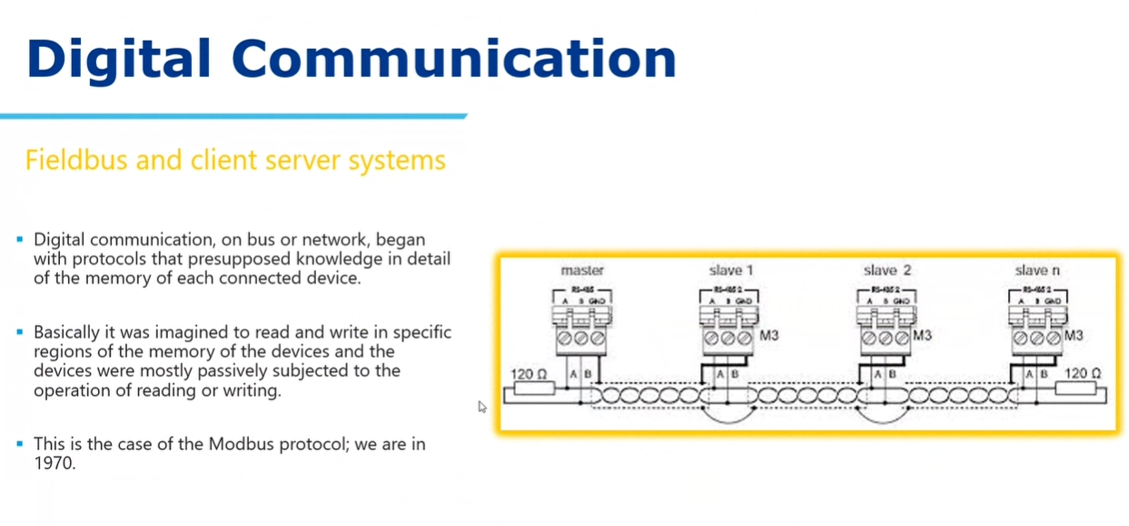
Digital Communication
Fieldbus and client server systems
Digital communication, on bus or network, began with protocols that presupposed knowledge in detail of the memory of each connected device
Basically it was imagined to read and write in specific regions of the memory of the devices and the devices were mostly passively subjected to the operation of reading or writing.
This is the case of Modbus protocol in 1970
Modbus is a data communications protocol originally published by Modicon in 1979 for use with its programmable logic controllers. Modbus has become a de facto standard communication protocol and is now a commonly available means of connecting industrial electronic devices.

Slide 8
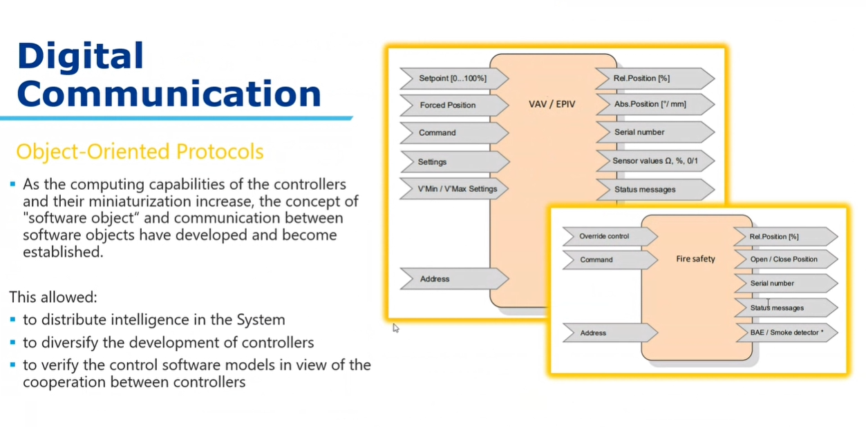
Object-Oriented protocols in digital communication

Slide 9
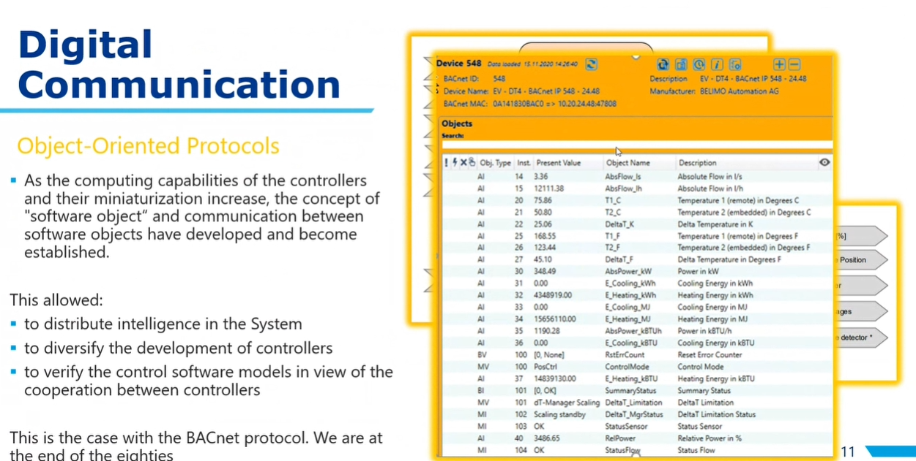
Object-Oriented Protocols in digital communication contd..

Slide 10
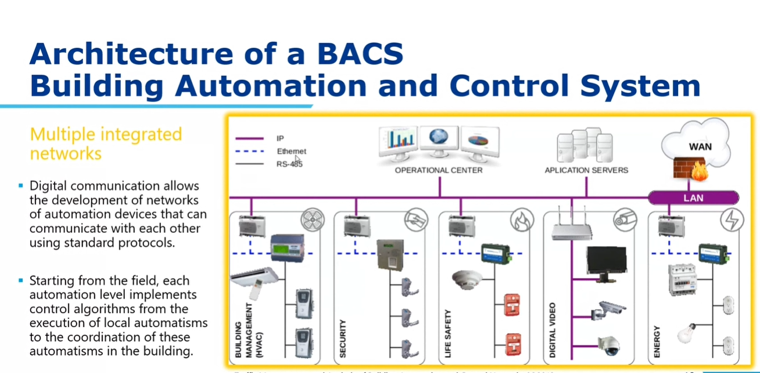
Architecture of a BACS Building Automation and Control System

Slide 11
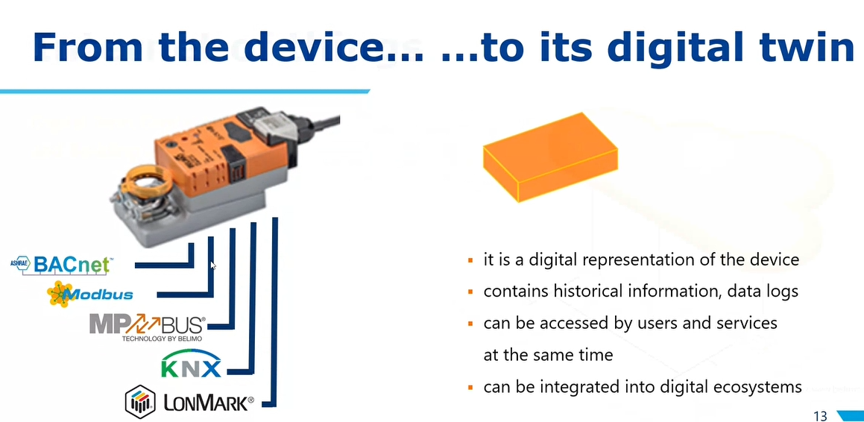
From the device to its digital twin
- A digital twin is a digital replica of a living or non-living physical entity. Digital twin refers to a digital replica of potential and actual physical assets, processes, people, places, systems and devices that can be used for various purposes.
- We have an actuator, a physical device, and we integrate digital signal processing component within it. Later we can introduce different kind of protocols

Slide 12
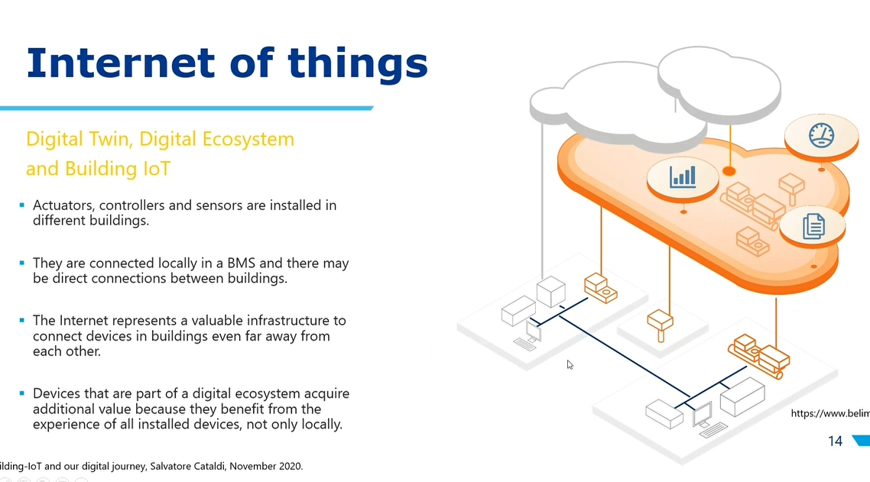
Internet of things Digital Twin, Digital Ecosystem and Building IOT

Slide 13
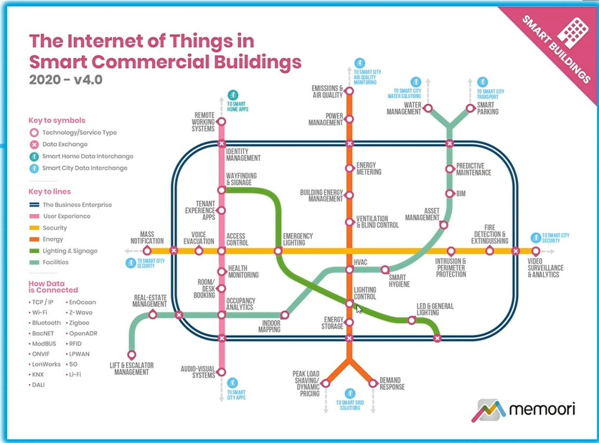
Building-IOT domains

Slide 14
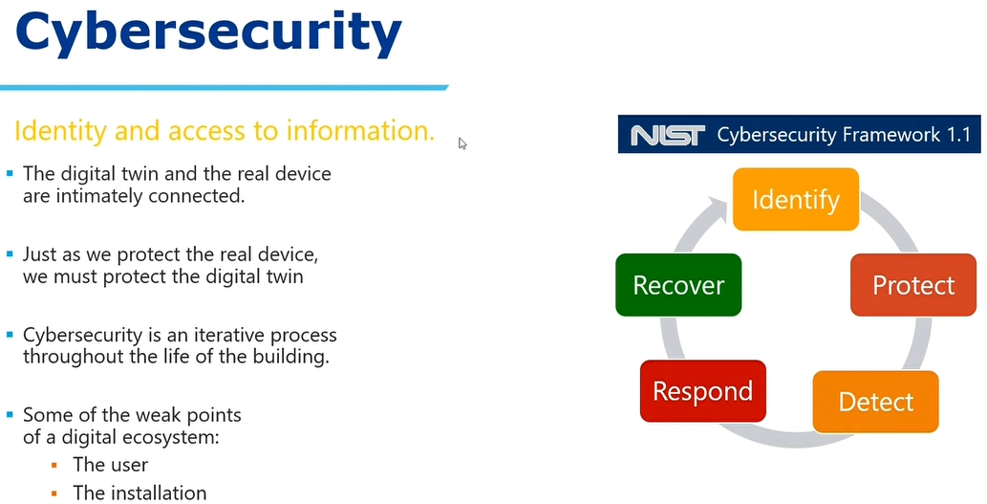
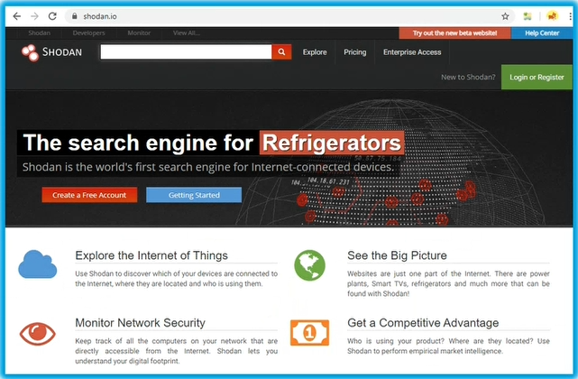
Cybersecurity

Slide 15
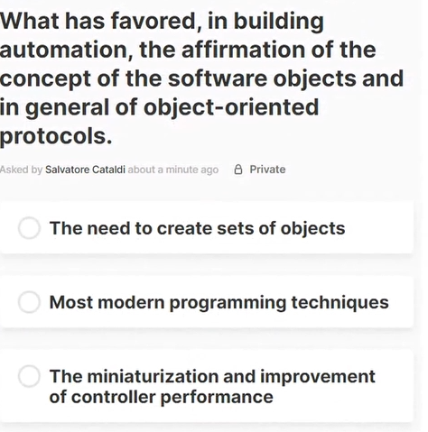
What has favoured in building automation, the affirmation of the concept of the software objects and in general of object-oriented protocols
The miniature and improvement of controller performance.

Slide 16
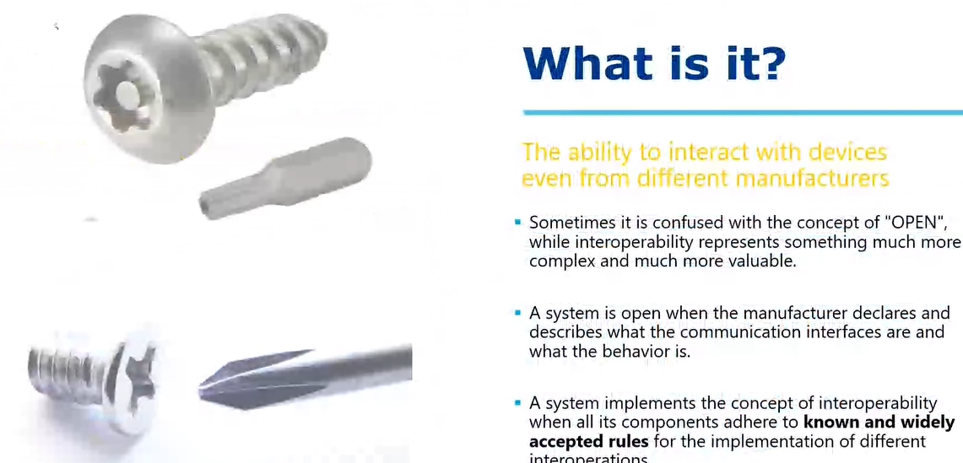
Interoperability
- The picture shows the items which are open.

Slide 17
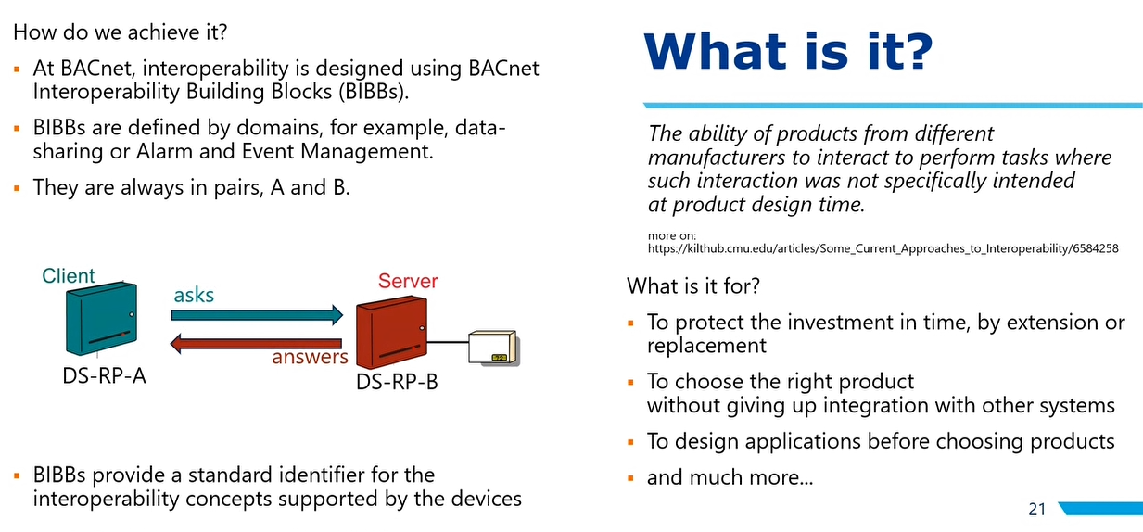
What is interoperability
- BIBBs(BACnet Interoperability Building Blocks)

Slide 18
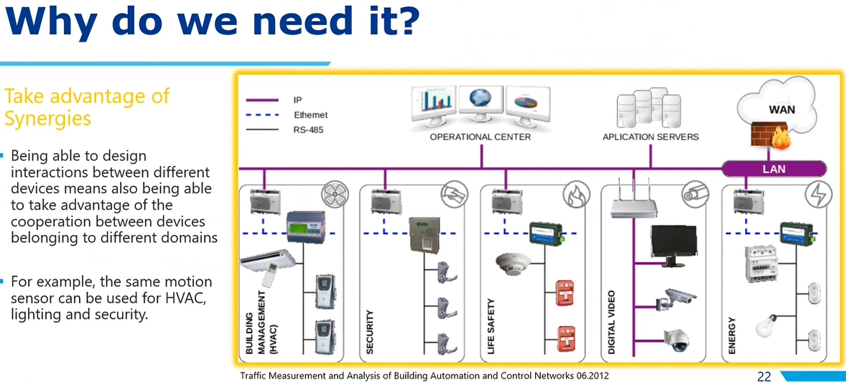
Why do we need interoperability?

Slide 19
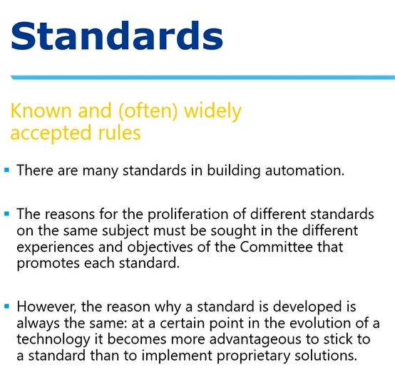
Interoperability is all about standards

Slide 20
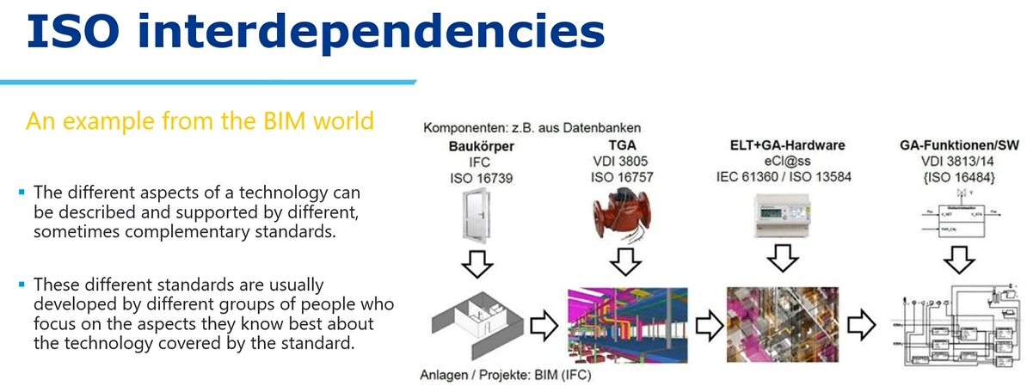
Interoperability- standards-iso interdependencies
- BIM(Building Information Model)

Slide 21
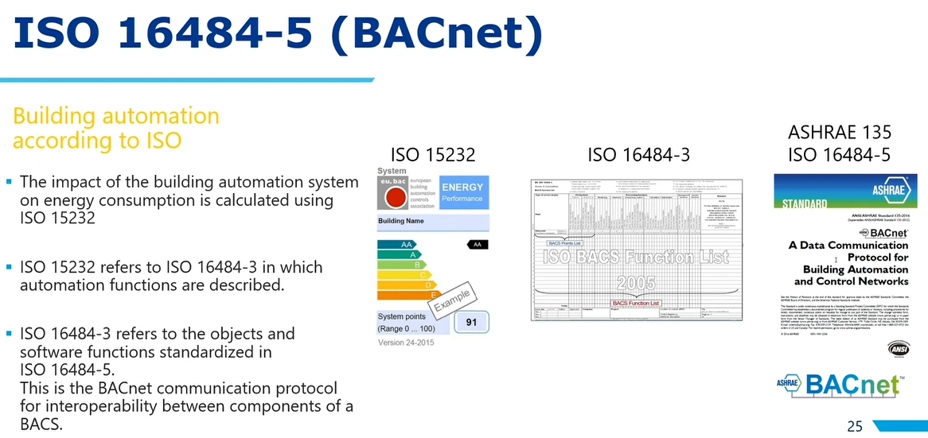
Building Automation according to ISO
My Building automation is completely ISO certified and now, with that ISO stamp on every aspect; I can sell my product at better prices.

Slide 22
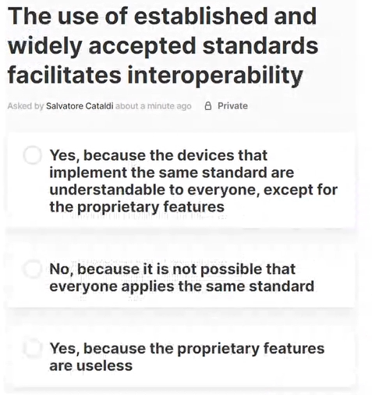
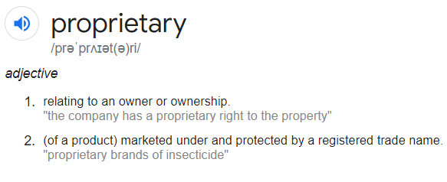
The use of established and widely accepted standards facilitates interoperability
Yes, because the devices implement the same standard which are understandable to everyone, except for the proprietary features

Slide 23
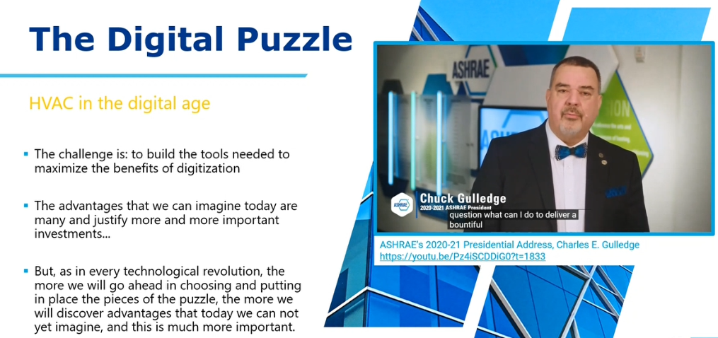
The digital puzzle HVAC in the digital age

Slide 24
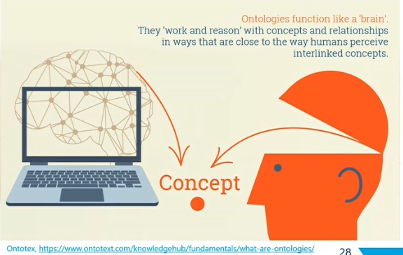
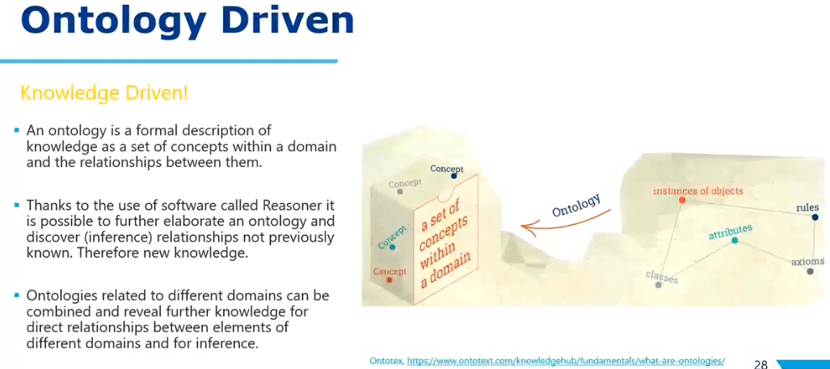
Ontology and mixing of different ontologies

Slide 25
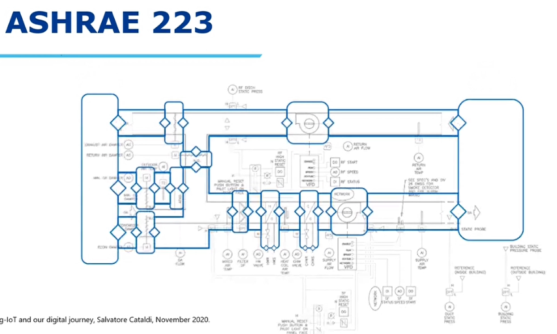

Slide 26
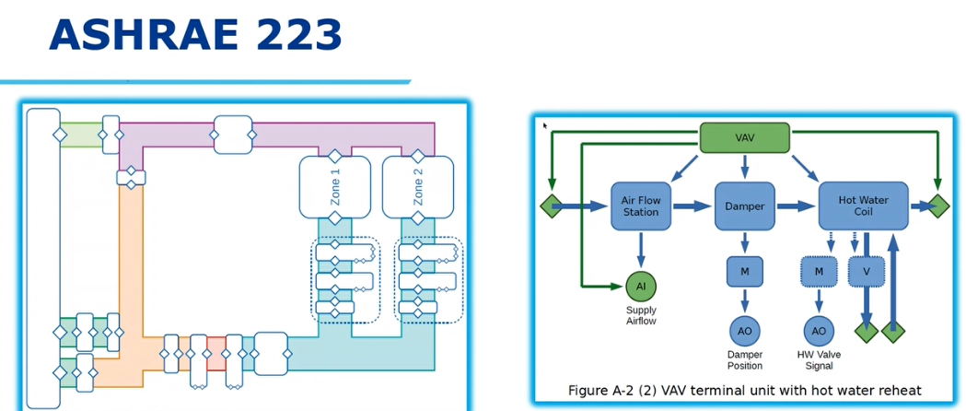

Slide 27
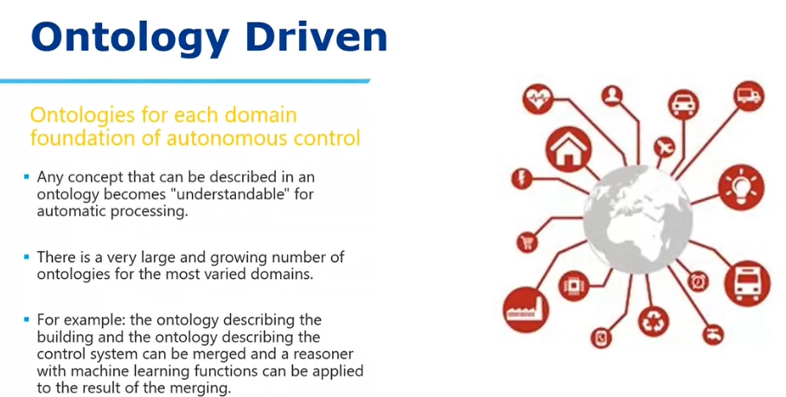
Ontology contd..

Slide 28
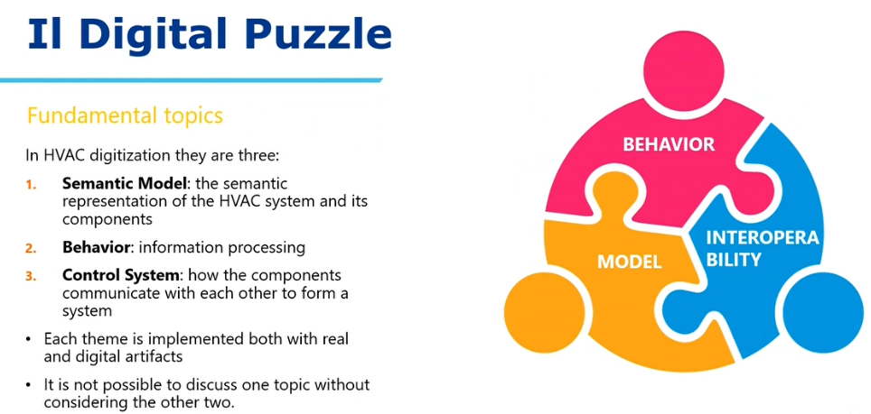
Digital Puzzle Summarization

Slide 29
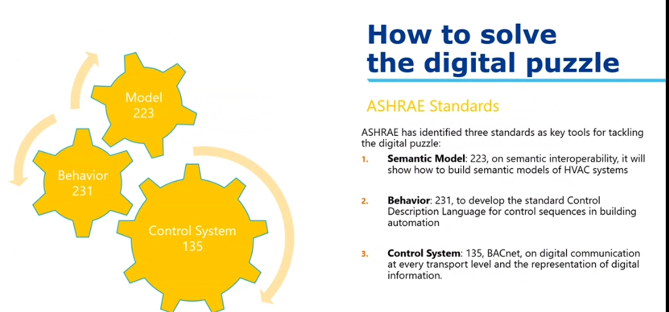
How to solve the digital puzzle
- ASHRAE has implemented certain standards within their organization. After formal standardization they connect the ISO to make it global or whatever

Slide 30
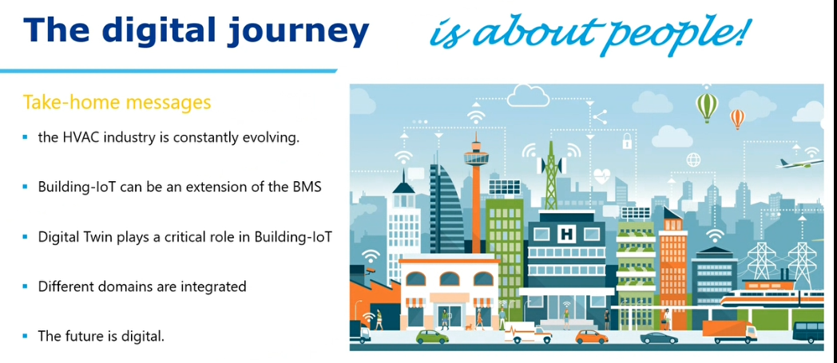

Slide 31
The standard protocols used by Transport Layer to enhance its functionalities are TCP(Transmission Control Protocol), UDP( User Datagram Protocol), DCCP( Datagram Congestion Control Protocol) etc.
BACNET(Building Automation and Control Network) is also a TCP protocol. It treats item as objects.
Modbus is also a TCP protocol which uses items as list of memory registers
EU standard is eubac.
Protocols of building Management, whatever is out there is based on specific goals. Yes, there is a competition between different protocols but mostly the protocols are specific goal oriented.

